Slide 1

MIT FORUM
Team Members:
Naren Karthikeyan B(2022506133)
Aadharsh S(2022506132)
Karthickannan A(2022506023)
Janesh S(2022506002)

Slide 2

What we have created is a simple, easy-to-use and a carefully crafted forum for our college. Our aim is to create a platform for students of our college to share their views on topics associated to MIT and also to inculcate intellectual discussions about them.

Slide 3
Chapters
1
2
3
4
5
Database Structure
Signup and Login
Categories, posts and replies
User page
Creating categories and posts

Slide 4

Chapter 1
Database structure

Slide 5
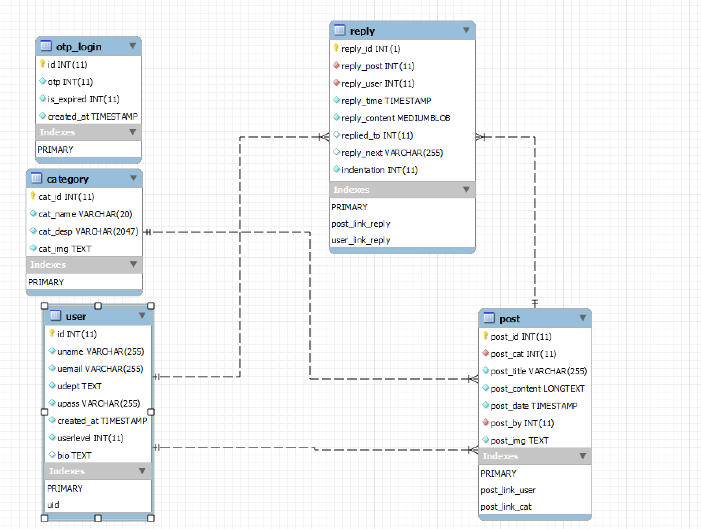
Database diagram

Slide 6
Description
Our database contains five tables:
User
Category
Post
Reply
OTP Login
Each table has its own primary key to make retrieval based on conditions possible and conflict-free. We have also turned on auto-increment for these columns so that uniqueness condition of primary key is always satisfied.
Foreign key relations have been made between these tables to never make unwanted changes.

Slide 7
User Table
This table is for storing information about the users. Here, ‘id ‘is the primary key.
We store the following information:
User id (id with datatype int)
Username (uname with datatype varchar)
User’s Email id(umail with datatype varchar)
User’s Department(udept with datatype text)
User’s password(upass with datatype varchar)
User creation time(created_at with datatype timestamp)
Userlevel(userlevel with datatype int)
User’s biography(bio with datatype bio)

Slide 8
User table (contd…)
Special features of this table
Upass’s value is inserted after the password is encrypted using the popular encryption algorithm sha1. This is to make sure that no hacker who gets access to our database ,to never get hold of users’ passwords.
Created_at is never required to be updated manually as the default value is set as current_timestamp() function.
Userlevel is to distinguish between normal user and admins. Admins get a userlevel of 1 while normal users get 0. Normal users can be upgraded to admins only by us.

Slide 9
otp_login table
Every user has to enter a randomly generated 6 digit otp(one time password) to login to our forum.
This otp is stored in this table. It has a ‘created_at’ column whose default value is current_timestamp(). This is to set expiration feature to this otp step. An otp has a validity of 15 minutes. This is achieved through ‘date_add()’ function.

Slide 10
Category table
This table is for storing the categories. Here, cat_id is the primary key.
Cat_name column contains the name of the category.
Cat_desp column contains the description of the database. It can store a maximum of 2047 characters.
Cat_img contains the address of the category image. The name of the category image is generated through random number generator function to avoid unnecessary problems.
Only an admin(userlevel 1) can create a category.

Slide 11
Post table
This table is storing posts related to a certain category.
Columns of this table are as follows:
Post id(post_id with datatype int)
Category to which the post belongs to(post_cat with datatype int)
Title of the post(post_title with datatype varchar)
Content of the post(post_content with datatype longtext)
Time at which the post is created(post_date with datatype timestamp)
User who creates the post(post_by with datatype int)
Image of the post(post_img of datatype text)

Slide 12
Post table
Post_by column contains the user id of the user who creates the post. This is very helpful while creating the user page.
Post_date has the default value of current_timestamp() which automatically enters the time of creation of the record.
Post_cat column contains the cat_id of the category table which is helpful while showing the posts of a certain category.
Post_img column stores the address of the uploaded post image.

Slide 13
Reply table
This table is for storing the replies for each post. It is a relatively simple table than other tables. It has a unique property of self-referencing. Here, reply_id is the primary key.
Reply_post contains the id of the post in which the reply was the added.
Reply_user contains the id of the user who created that reply.
Reply_time stores the time at which reply was added.
Reply_content stores the content of the reply. It’s datatype is medium blob (length: 224 – 1 bytes) to store replies with even more than 1000 words.
Reply_next, repliedto handles the next and previous links to the current reply while indentation is for presentation purpose. Lower down the reply node is in the reply tree, more indentation it will get.

Slide 14
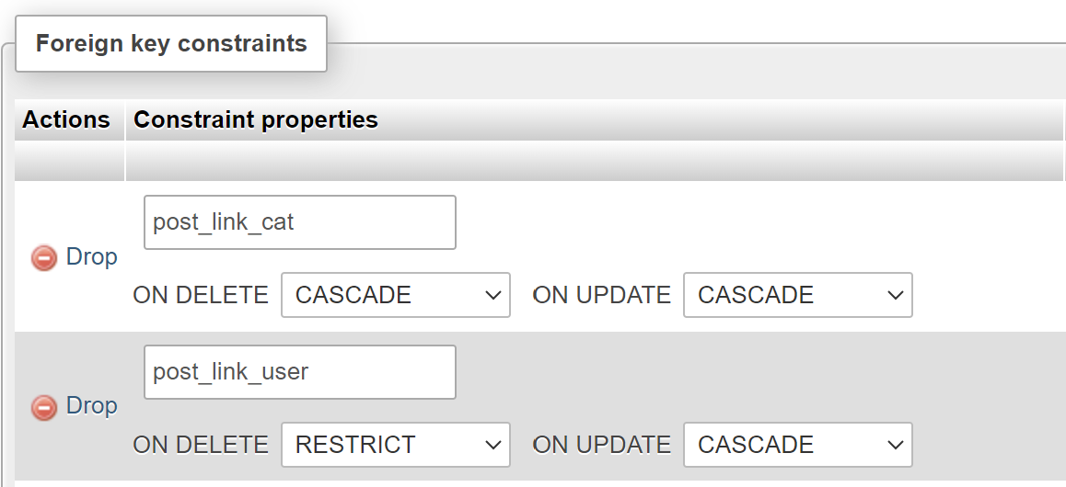
Foreign keys
Cascade option is turned for both delete and update for post_link_cat so that all the posts delete or update if category is deleted or updated.
In post_link_user, restrict option is turned on for deletion as the user may accidently delete all their posts if they delete their account
The post table is connected to category table and user table as these distinctly define a post. Therefore, we have two foreign keys post_link_cat and post_link_user. Cascade and delete options are turned on for data integrity.

Slide 15
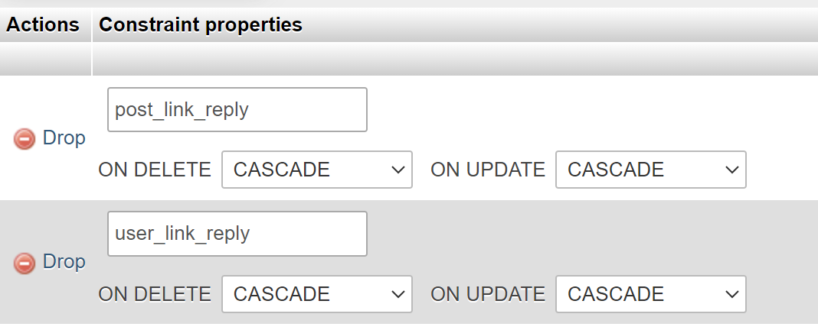
Foreign keys(contd..)
Reply table is connected to user and post table as they distinctly define any reply.
It’s relational structure is much simpler than that of the post table. Cascade option is turned on for all deletion and update activities.
Additionally, reply table has a special foreign key that references the reply-id of its table. This is for managing reply_next and repliedto.

Slide 16

Chapter 2
Signup and login

Slide 17
User registration
Signup is handled by these files:
Signup.php
Sign_action.php
Signupvalidate.js
Signstyle.css
Signupvalidate.js makes sure that username doesn’t contain any symbols and a check is done is processing side to make sure that the username is unique.
Password, department and email fields are also validated in the javascript file.
Password is passed through sha1 encryption before storing it in the database. This is achieved using sha1()in php.

Slide 18
User Registration
If all the fields are properly verified then the user is added to the databased. Then the user has to login to start an active session which is open as long as the browser is running.

Slide 19
Login
The login is handled by the following files:
Login.php
Login_action.php
Loginvalidate.js
Loginstyle.css
There are two fields in this file: username and password. Upon entering correct credentials, user is redirected to otp page.
There is a provision to view the hidden password by clicking on the eye icon.

Slide 20
OTP Validation
After correctly entering the username and password, otp is sent to the user’s email. A six-digit otp is randomly generated through rand()function.
A Google SMTP(Simple mail transfer protocol) server is used to send the otp to the user. This is managed by mailsendersmtp.php.
There is also a expiration time for this otp. It is valid only for 15 minutes. This is achieved through the following things:
OTP creation time is stored in the database. Expiration is managed through DATE_ADD(created_at, INTERVAL 15 MINUTE). This adds 15 minutes to the creation time and check is done to make sure that current time is lesser than this new timestamp created through date_add() function.

Slide 21

Chapter 3
Categories, posts and replies

Slide 22
Categories,posts and replies
Basic structure of our forum looks like this:
Categories → posts related to the category → replies to the selected post.
Categories are basically communities related to several topics like sports, events, academics etc..
User can discuss about these topics through the forms of posts and replies to those posts.
Posts and replies are moderated by the admins to make sure that all the contents are safe for all the users.

Slide 23
Categories
A category has five components:
Cat_id(unique id that defines a category)
Category name
Category image
Category description
Posts related to the category.
These categories are displayed as blocks and all these blocks are clickable. Clicking action redirects the user to the posts page.

Slide 24
Categories
Categories are managed through the following files:
Viewcat.php
Catstyle.css
Cat_post.js
Cat_post.js has two functions. It makes the div blocks clickable and also transfers the cat_id to the post page so that related posts can be shown.
Grid display has been used to make sure that alignment doesn’t go out of hand when new categories are created. Height of the div blocks are automatically adjusted to fit the content and the image.

Slide 25
Posts
Posts page gets the cat_id from the viewcat.php and queries all the posts related to the category.
Posts contain the following elements:
Post title
Post image
Post content
ID of the post creator
Time of creation
Category in which the posts are posted.
Replies to the post

Slide 26
Posts
Post table is used in two ways: to display all the posts, to display all contents along with the replies.
The display is managed by the following files:
Viewpost.php
Poststyle.css
Post.js
Like categories, viewpost.php displays all the posts as div blocks which are clickable. Upon clicking on them, the user is redirected to the fullpost.php.
A post contains the date at which the post was created, the user who created the post in addition to title and content. The user is a clickable element which redirects to the user page.

Slide 27
Posts
As explained before, clicking on the post redirects to the fullpost page. Fullpost is a full fledged page that displays the title, image and content in a easy-to-read manner.
The fullpost page is maintained by the following pages:
Fullpost.php
Fullpost.js
Fullpost.css
Below the post section, user can find a reply section.
Fullpost.js simply makes sure that any time a reply is added, it is shown immediately rather than requiring the user to reload the page.

Slide 28
Replies
Reply section of the fullpost page has two functions:
Display all the replies.
Add a reply.
Replies are displayed in descending order of creation. The latest reply comes first. This is achieved by storing the reply creation time in the reply table.
Reply may contain any sort of symbols including quotations which might throw an error when it is passed through simple mysqli_query() function so prepared statements are used to securely store the replies in the reply table.
Each reply is a node in a directed uncyclic graph. We have traversed through them using depth first search

Slide 29

Chapter 4
User page

Slide 30
User page
Any forum has a user page that shows information about the users and the posts posted by them. Our user page also has similar structure.
Following elements are present in the user page:
Username
Department
Biography(if present)
Posts
If the user clicks on their user page and if the bio is unavailable then a textbox is shown that the user may click on to add a bio. If someone clicks on the page that is not theirs then the textbox is not shown but a ‘no bio available’ message is shown.

Slide 31
User page
Below the user section, posts are shown. Like the category and posts, these are clickable div blocks which directs to fullpost page upon clicking on them.
These posts are shown as cards. The parent div has a grid display turned to make sure new posts doesn’t butcher the alignment that is already in place.
If no posts are available then a simple “no posts” message is shown.
When a user logs in, then their username is shown at the right corner from which the user can access their page.
Every post also has a clickable username section which redirects to that user page.

Slide 32

Chapter 5
Creating posts and categories

Slide 33
Creating categories
Categories are very important and meticulously maintained by the admins. Therefore, we have only made the admin have privilege to add categories. Normal users can only request for a category.
Only the creators have the ability to turn normal users into admins. Usually, a signup page creates a user with a user level 0.
This category creation is maintained by these files:
Create_cat.php
Ccat.css
Admins are asked to enter category name, image and description.

Slide 34
Creating categories
Image uploading is managed through $_FILES superglobal. Once an admin uploads, the image is uploaded to the server. The image can be accessed through $_FILES[‘tmp_name’].
Then the built-in function called move_uploaded_file() to transfer file from the server to the local machine.
Sometimes, the image file can have spaces or any other unwanted characters which may throw an error. So image file name is created through rand() function and that becomes the new name of the image file. Images are all stored in the img subfolder of the assets folder.

Slide 35
Creating posts
Creating posts are similar to creating categories. Post permission is turned on only if the user logs in. As soon as the user logs in, $_SESSION[‘post_perm’] is turned true.
Like category, the logged-in user has to enter post title, image and its content.
Creation of posts is maintained by the following files:
Create_post.php
Process_post.php
Cpost.css

Slide 36
Room for improvement
Content Moderation
Rather than having only a handful of admins doing content moderation, moderators can be created for each category.
Automatic content moderation systems can be put in place to make it more efficient
Real time chatting
Real time chatting opportunity can be created to make users interact with others more easily

Slide 37
Thank you

